Slide 1


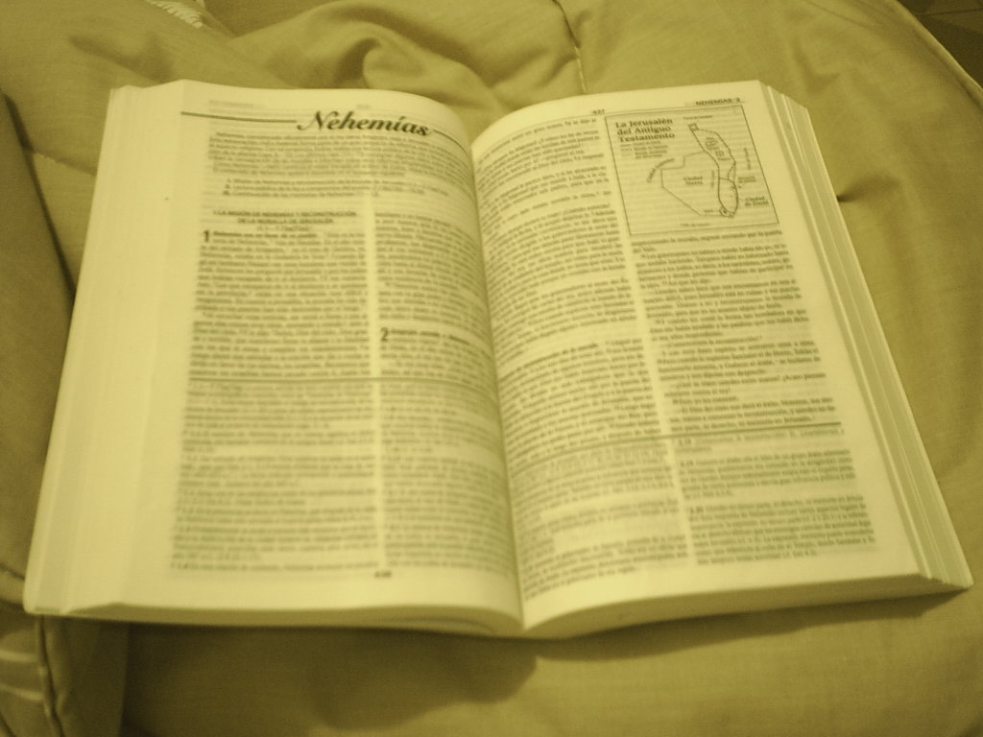
Comunicación y Gerencia
10 Commandments
For effectvie eMail communication

Slide 2

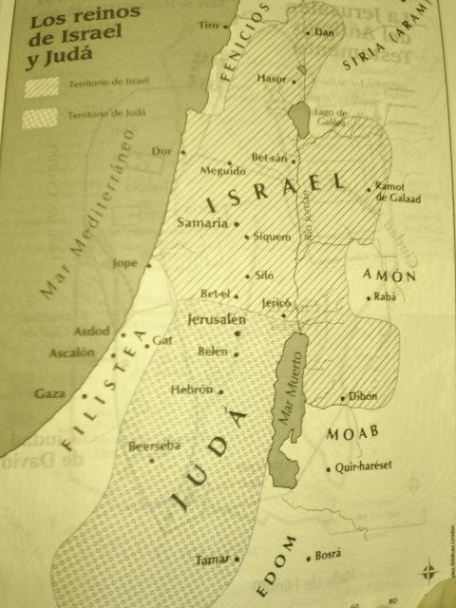
“Etiquette is a sensitive awareness of the feelings of others. If you have that awareness, you have good etiquette”

Slide 3
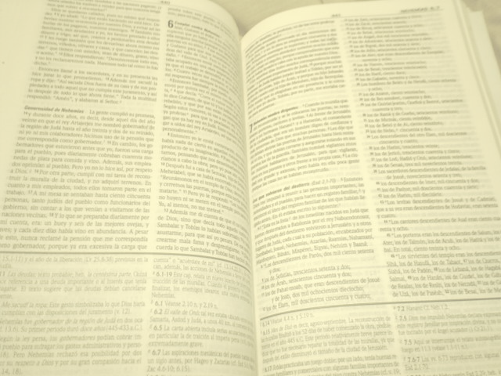
1
Be concise and to the point
Do not make an e-mail longer than it needs to be. Remember that reading an e-mail is harder than reading printed communications and a long e-mail can be very discouraging to read.

Slide 4
2
Answer all questions, and
pre-empt further questions
An email reply must answer all questions, and pre-empt further questions –if you are able to pre-empt relevant questions, your customer will be grateful and impressed with your efficient and thoughtful customer service.

Slide 5
3
Use proper spelling,
grammar & punctuation
This is important for conveying the message properly. Mistakes will distract the readers and can even change the meaning of the text. Your program has a spell checking option, why not use it?

Slide 6
4
Do not attach
unnecessary files
By sending large attachments you may clog the recipients e-mail system. Only send attachments when they are essential. Ensure that the attachments are scanned for viruses before sending.

Slide 7
5
Do not overuse
Reply to All
Only use Reply to All if you really need your message to be seen by each person who received the original message.
Take extra care when the reply contains eMail groups as eMail group consist of many email IDs.

Slide 8
6
Use a meaningful
subject
Try to use a subject line that is meaningful and conveys the purpose of the mail.

Slide 9
7
Avoid using “Urgent”
and “Important”
You must at all times try to avoid these types of words in an email or subject line. Only use this if it is a really, really urgent or an important message.

Slide 10
8
Avoid long sentences
Try to keep your sentences to a maximum of 15-20 words as far as possible.

Slide 11
9
Do not write in
“CAPITALS”
IF YOU WRITE IN CAPITALS IT SEEMS AS IF YOU ARE SHOUTING. This can be highly annoying and might trigger an unwanted response. Therefore, try not to send any email text in capitals.

Slide 12
10
Use cc:
field sparingly
CC: field is to be used for recipients who are supposed to be informed about the communication in the mail. But are not expected to act on it. When responding to a cc: message, include only those persons who need to be a part of the communication.

Slide 13
Thank You…

